Slide 1
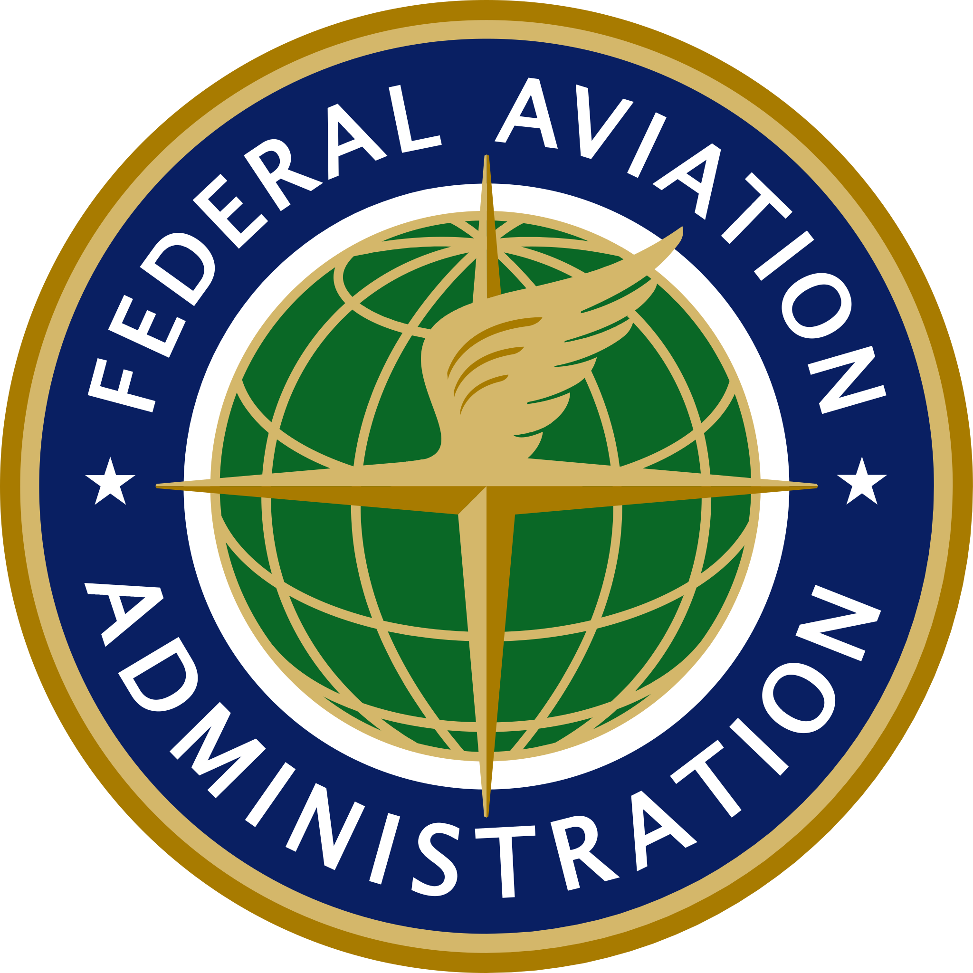
Domestic Events Network
Parker Corts
HQ Senior Representative to USINDOPACOM
and PACAF, AJR-25 Special Operations

Slide 2
Domestic Events Network
Agenda
Purpose of Federal Aviation Administration (FAA)
Air Traffic Control System Command Center (ATCSCC)
Domestic Events Network (DEN)

Slide 3
Domestic Events Network
FAA Authority
Authority granted to Federal Aviation Administration (FAA) by 49 U.S.C. 106:
Regulates civil aviation and U.S. commercial space transportation.
Maintains and operates air traffic control and navigation systems for both civil and military aircrafts.
Responsible for safely and efficiently managing the navigable airspace of the United States. This includes all civil and military aircraft.

Slide 4
Domestic Events Network
FAA Purpose
Federal Aviation Administration (FAA)- Provide the safest, most efficient aerospace system in the world.
Air Traffic Control (ATC)- The primary purpose of the ATC system is to prevent a collision involving aircraft operating in the system. In addition to its primary purpose, the ATC system also:
Provides a safe, orderly, and expeditious flow of air traffic.
Supports National Security and Homeland Defense missions.

Slide 5
Domestic Events Network
FAA Air Traffic Control System Command Center (ATCSCC)
This one-of-a-kind facility is dedicated to balancing the nation's air traffic demand with system capacity. Stakeholders include:
Air Traffic Control Facilities:
Air Route Traffic Control Centers (ARTCCs)
Terminal Radar Approach Control Facilities (TRACONs)
Air Traffic Control Towers (ATCTs)
Aviation Industry Partners
Military Representatives

Slide 6
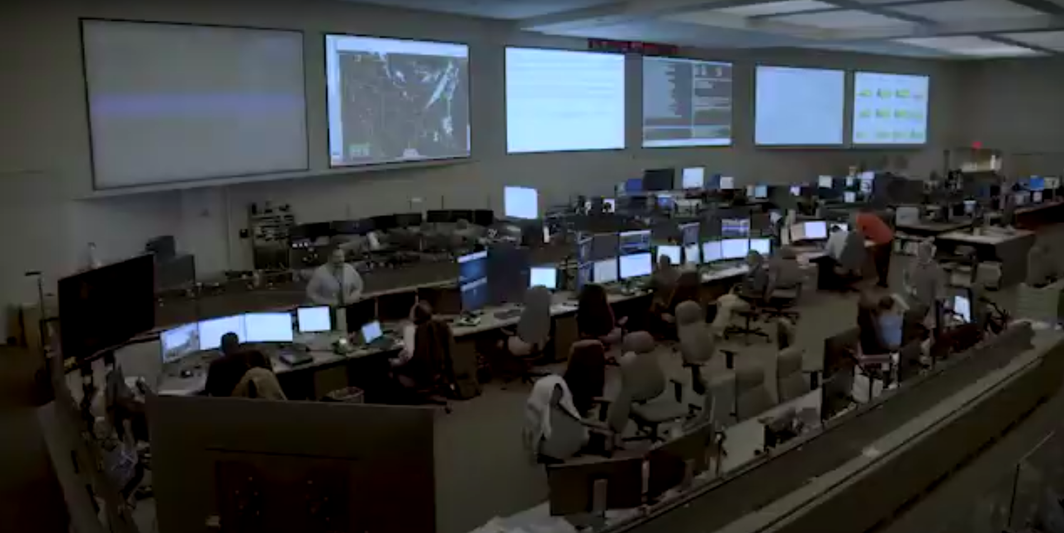
Domestic Events Network
Command Center Operations Floor

Slide 7
Domestic Events Network
Impact of September 11, 2001
On September 11, 2001, a conference call was established between the FAA and the DoD, to coordinate information concerning the hijacked aircraft. This conference call is called the Domestic Events Network (DEN).
A 24/7 interagency unclassified telephonic conference dedicated to real-time coordination.
The longest running teleconference in the world.
The DEN is the primary location for real-time information sharing among Government agencies and the private sector (e.g., airlines), on live security incidents involving the National Airspace System (NAS).
200+ government operations centers currently depend on the DEN to execute their aviation related national defense and homeland security statutory responsibilities.

Slide 8
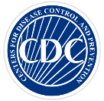
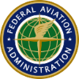
Domestic Events Network
DEN Participants
DEN Participants:
All ATC Facilities
Over 200 interagency nodes and as needed, select operators

Slide 9
Domestic Events Network
Information Shared on the DEN
Security incidents are shared by FAA Air Traffic Control (ATC), Transportation Security Administration (TSA), and Airlines.
Aircraft anomalies.
Medical events that may require Center for Disease Control (CDC) intervention.
Cockpit illumination by laser events.
Unauthorized Unmanned Aerial Systems (UAS) events.
Temporary Flight Restriction (TFR) and violators.
Disruptions to airports and air traffic systems that may impact air travel.

Slide 10
Domestic Events Network
QUESTIONS
Parker R. Corts
HQ Senior Representative to USINDOPACOM and PACAF, AJR-25 Special Operations
Air Traffic Organization | System Operations Services |System Operations Security
Federal Aviation Administration
Phone: 808-448-4999
Email: parker.corts@faa.gov

